Slide 1
Full Stack Web Development
K SuMANGALI
SCORE
Vellore Institute of technology

Slide 2
Syllabus for Module 1
Evolution of the Internet and World Wide Web - Introduction to HTML5 - Headings Linking, Images, Lists, Tables, Forms, New HTML5 Form Input Types, Page Structure Elements - Introduction to CSS - Inline Styles, Embedded Style Sheets, Linking External Style Sheets, Backgrounds, Element Dimensions, Box Model and Text Flow, Positioning, Media Types and Media Queries, Drop Down Menus Selectors, Text Shadows, Box Shadows

Slide 3
Evolution of the Internet and World Wide Web
What is Internet?
The Internet is a global network of interconnected computers and devices that communicate using standardized protocols, allowing for the exchange of information and data across the globe.
What is World Wide Web (www)?
The World Wide Web, often referred to as the WWW, is a system of interlinked hypertext documents and multimedia content accessed via the Internet. It's essentially the graphical interface that makes the vast resources of the Internet accessible to users.

Slide 4
Evolution of the Internet and World Wide Web
Origins of the Internet:
The story begins in the 1960s with the creation of ARPANET (Advanced Research Projects Agency Network). Developed by the United States Department of Defense, ARPANET was the first network to use packet-switching technology.
Development by the U.S. Department of Defense:
Funded by the U.S. Department of Defense (during the cold war), the ARPANET project aimed to establish a reliable means of communication between research institutions and government agencies.
ARPANET laid the foundation for what would eventually become the global network – INTERNET - we know today.

Slide 5
Evolution of the Internet and World Wide Web
The World Wide Web (WWW) and the invention by Sir Tim Berners-Lee
In 1989, Sir Tim Berners-Lee, a British computer scientist, conceived the idea of the World Wide Web.
His vision was to create a system that allowed researchers to share and access documents and information easily over the Internet.
Introduction of HTTP and HTML:
To achieve this, Berners-Lee developed the Hypertext Transfer Protocol (HTTP) as a standard for communication on the Web.
He also created the Hypertext Markup Language (HTML) for structuring and presenting documents, laying the foundation for the web pages we interact with today.

Slide 6
Evolution of the Internet and World Wide Web
Dot-Com Boom (1990s)
Commercialization of the Internet:
The early 1990s saw a shift from the Internet being primarily a tool for research and communication to a platform for commercial ventures.
Businesses recognized the potential of the Internet as a global marketplace, leading to increased investments in online ventures.
Rapid Growth of Online Businesses:
The Dot-Com Boom was characterized by a surge in the creation of online startups, often referred to as "dot-coms."
Companies like Amazon, eBay, and Yahoo became pioneers in e-commerce, online auctions, and web portals, respectively.

Slide 7
Evolution of the Internet and World Wide Web
Social Media and Web 2.0
Emergence of User-Generated Content:
The evolution of the Internet has not only been about connecting people but also about enabling them to share, collaborate, and create content. This shift towards a more interactive and social web is often referred to as Web 2.0.
Platforms like blogs, forums, and social media encouraged users to share their thoughts, opinions, and creative works.
Social Networking Platforms (Facebook, Twitter):
The 2000s saw the rise of social networking platforms that revolutionized online social interactions. Facebook and Twitter (Now called X), became a global phenomenon, connecting people and reshaping the way we share our lives.
Web 2.0 fostered collaboration and collective intelligence. Wikis, collaborative editing, and open-source projects became prevalent, example - Wikipedia

Slide 8
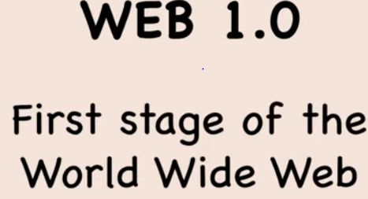
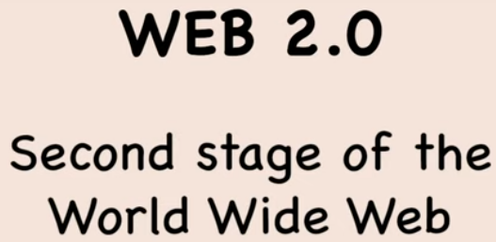
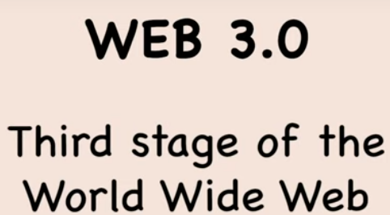
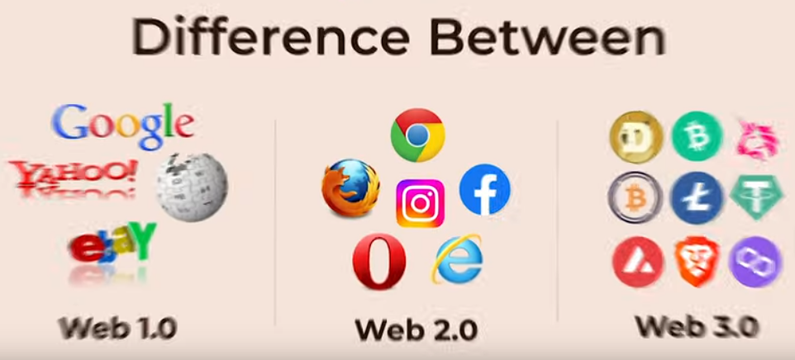
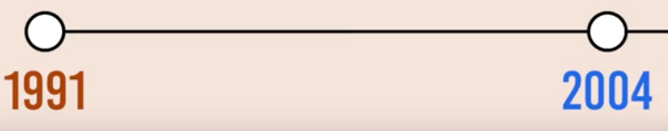
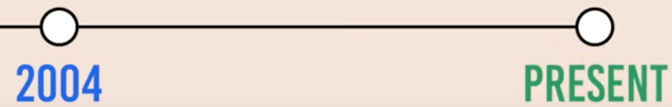


Slide 9
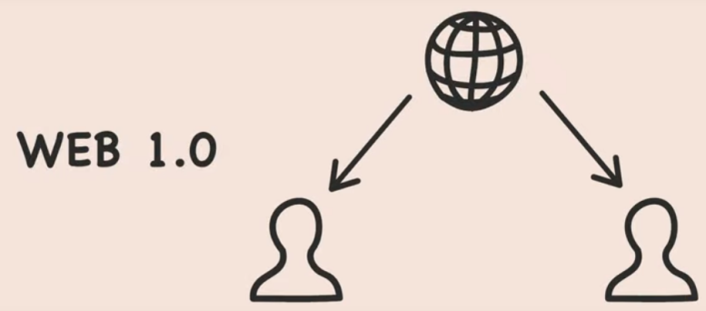
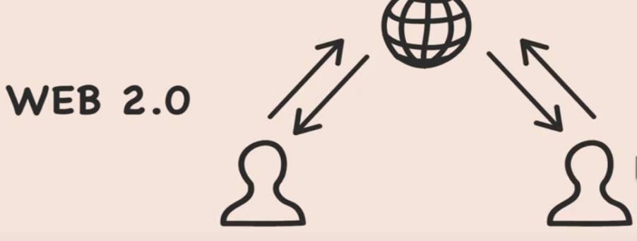

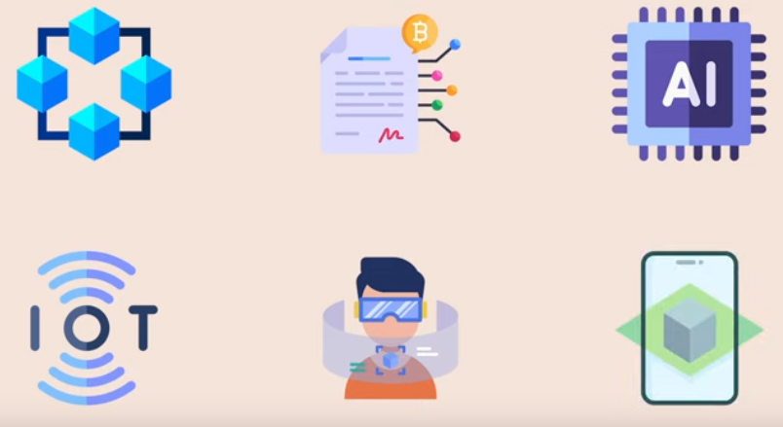
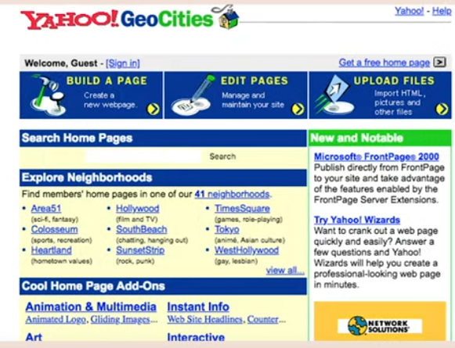

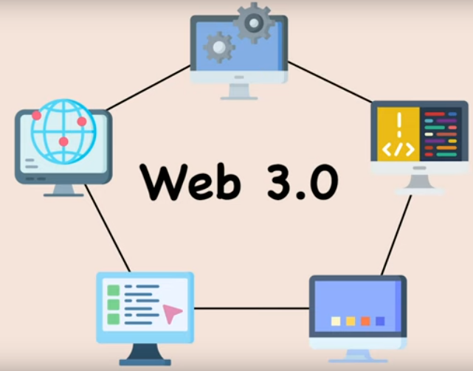

Slide 10
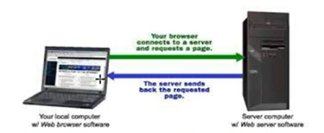
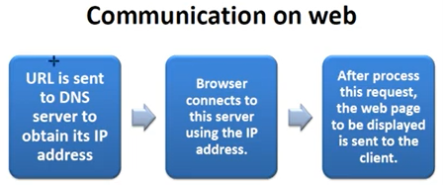
Communication on Web
Web based communication refers to exchanging information, i.e., sending and receiving information via the internet. It can be done through various means, including email, instant messaging, social networking, and video conferencing.

Slide 11
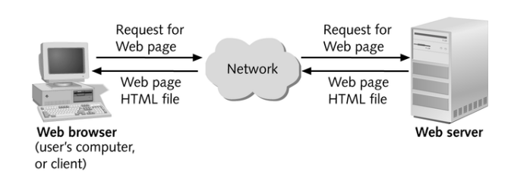
Web Architecture
Web Architecture is the conceptual structure of the World Wide Web (WWW). The WWW or internet is a constantly changing medium that enables communication between different users and the technical interaction (interoperability) between different systems and subsystems.

Slide 12
Web Architecture
The web architecture is classified into three categories1-tier, 2-tier and n-tier. Basically, the web is a 2-tiered architecture. A web browser displays information content and a web server that transfers information to the client.
The basis of web architecture is different components and data formats, which are usually arranged in tiers and build on each other.
Overall, they form the infrastructure of the internet, which is made possible by the three core components of data transmission protocols (TCP/IP, HTTP, HTTPS), representation formats (HTML, CSS, XML), and addressing standards (URI, URL).

Slide 13
Web Architecture - Layers
Presentation Layer
Static or dynamically generated content rendered by the browser (front-end)
Logic Layer
A dynamic content processing and generation level application server, e.g., Java EE, ASP.NET, PHP, ColdFusion platform (middleware)
Data Layer
A database, comprising both data sets and the database management system or RDBMS software that manages and provides access to the data (back-end)

Slide 14
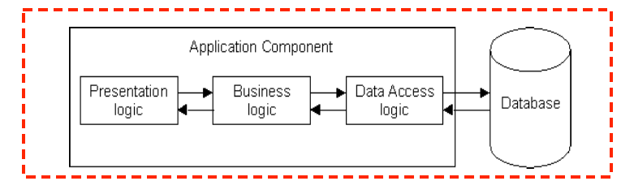
1-Tier Architecture
All 3 layers are on the same machine
All code and processing kept on a single machine
Presentation, Logic, Data layers are tightly connected
Scalability: Single processor means hard to increase volume of processing
Portability: Moving to a new machine may mean rewriting everything
Maintenance: Changing one layer requires changing other layers

Slide 15
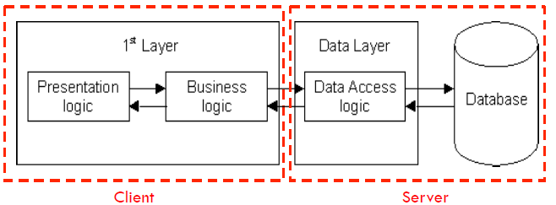
2-Tier Architecture
Database runs on Server
Separated from client
Easy to switch to a different database
Presentation and logic layers still tightly connected
Heavy load on server
Potential congestion on network
Presentation still tied to business logic

Slide 16
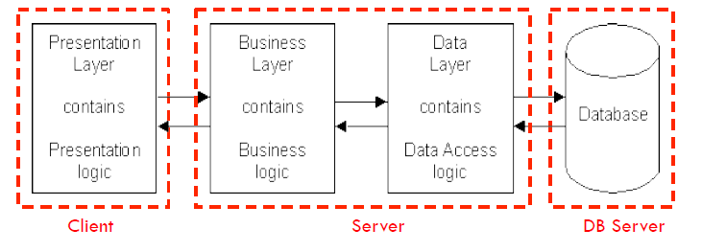
3-Tier Architecture
Each layer can potentially run on a different machine
Presentation, logic, data layers disconnected
Presentation Layer
contains Presentation Logic
Business Layer
contains Business Logic
Data
Layer
contains Data Access Logic
Database

Slide 17
Evolution of the Internet and World Wide Web
Introduction to Web Architecture
Web architecture refers to the structure and organization of components in a web application. It evolves to accommodate the growing complexity of applications and user demands.
Components of Web Architecture:
User Interface: The HTML, CSS, and possibly some client-side JavaScript for the presentation layer.
Application Logic: Minimal or no server-side scripting. The website is mainly composed of static content.
Data Management: The content is hardcoded directly into the HTML files, and there's no dynamic interaction with a database.

Slide 18
Evolution of the Internet and World Wide Web
1-Tier Architecture
1-tier architecture, also known as single-tier is the simplest form.
Characteristics:
Simple and straightforward
Suitable for small-scale applications with minimal complexity.
All components (presentation, application, and data management) reside on a single machine.
Example Scenario: A personal blog - A static blog website where the content is predefined and doesn't change frequently. Each page of the blog is an HTML file containing the blog post content, and there's no need for server-side processing or interaction with a database.

Slide 19
Evolution of the Internet and World Wide Web
It's important to note that while 1-tier architecture is suitable for simple scenarios, it lacks the flexibility and scalability needed for more complex and dynamic web applications.
As web development requirements evolve, architectures like 2-tier or 3-tier become more common to accommodate scalability, maintainability, and dynamic content needs.

Slide 20
Evolution of the Internet and World Wide Web
2-Tier Architecture
2-tier architecture introduces a separation between the client and the server, dividing the application logic and data management. In this structure:
Components:
Client-side for presentation.
Server-side for application logic and data management.
Characteristics:
Enhanced scalability and manageability compared to 1-tier.
Commonly used in client-server applications.
Example:
Client-server database applications.

Slide 21
Evolution of the Internet and World Wide Web
3-tier architecture
3-tier architecture further divides the application into three interconnected components, enhancing modularity and flexibility. In this structure:
Components:
Presentation layer (Client).
Application layer (Server).
Database layer (Storage).
Characteristics:
Improved scalability, maintainability, and flexibility.
Commonly used in modern web applications.
Example:
Web applications with a separate server for business logic and a database for data storage.

Slide 22
Evolution of the Internet and World Wide Web
Internet Protocol
Internet Protocol (IP) is a fundamental set of rules and conventions that govern how data is transmitted and communicated across computer networks, including the global network known as the Internet. It provides the foundation for the design and functioning of the Internet by establishing the standards for addressing, routing, and fragmenting data into packets.
Key aspects of Internet Protocol (IP) include:
Addressing
Routing
Packetization
Versioning

Slide 23
Evolution of the Internet and World Wide Web
1. Addressing: IP assigns a unique numerical label, called an IP address, to each device connected to a network. IP addresses allow devices to be identified and located on the network.
2. Routing: IP facilitates the routing of data packets from the source to the destination across interconnected networks. Routers, which are devices responsible for directing data traffic on the Internet, use IP information to determine the most efficient path for packet delivery.

Slide 24
Evolution of the Internet and World Wide Web
3. Packetization: IP breaks down data into smaller units called packets for efficient transmission over the network. Each packet includes information about the source and destination IP addresses, allowing routers to forward them to the correct destination.
4. Versioning: There are two main versions of IP addresses: IPv4 (32-bit) and IPv6 (128-bit).
IPv4 (Internet Protocol version 4): The original and most widely used version, which uses a 32-bit address space. However, IPv4 addresses are becoming scarce due to the increasing number of connected devices.
IPv6 (Internet Protocol version 6): Developed to address the limitations of IPv4, IPv6 uses a 128-bit address space, providing a vast number of unique addresses to accommodate the growing number of devices connected to the Internet.

Slide 25
Evolution of the Internet and World Wide Web
Transmission Control Protocol (TCP) and User Datagram Protocol (UDP): IP works in conjunction with higher-layer protocols like TCP and UDP. TCP provides reliable, connection-oriented communication, ensuring that data is delivered accurately and in order. UDP, on the other hand, is a connectionless protocol that offers faster but less reliable communication.
Internet Protocol Suite (TCP/IP): IP is part of a broader suite of protocols known as the Internet Protocol Suite or TCP/IP (Transmission Control Protocol/Internet Protocol). This suite includes various protocols that collectively enable communication on the Internet.

